Slide 1
The Cannabis Conundrum
James L. Day, Bush Kornfeld, Seattle
Keri L. Riley, Kutner Brinen, Denver
John M. Hickey, Hall Estill, Tulsa
Hon. Elizabeth E. Brown, Denver, Moderator

Slide 2
Cannabis is Big Business
Per the US Census data for 2018 Oklahoma’s population was 3,943,000
Per the Oklahoma Medical Marijuana Authority on 7/29/18 there had been issued
170,404 patient licenses
3,733 grow licenses
1,708 dispensary licenses
984 processor licenses
Total 6,425 MMJ businesses were started since September of 2018

Slide 3
Who Loves You, Baby?
Recreational marijuana is currently legal in 11 states and the District of Columbia
Washington: I-502 passed in November 2012 by a 56 – 44% margin.
Medical marijuana legal in another 20 states
Wholly illegal in 19 states
Projected Revenues:
Washington State: $730 million for 2017-19 budget cycle
Excise tax rate: 37% on retail sales

Slide 4
Not the Feds: Controlled Substances Act
Marijuana classified as a Schedule I Drug, which the statute defines as:
“[H]igh potential for abuse”
“[N]o currently accepted medical use in treatment in the United States”
“[L]ack of accepted safety for use of the drug or other substance under medical supervision”
Included with LSD, Heroin, and Ecstasy

Slide 5
Changing of the Guard
United States Trustee Directive of April 26, 2017:
Trustees must move to dismiss or object whenever marijuana assets are involved because they may not be administered under the Bankruptcy Code

Slide 6
The Rule of Law
Sessions Memorandum, January 4, 2018: “Announcing a return to the rule of law”
Directs all US Attorneys to enforce the laws enacted by Congress

Slide 7
Clifford J. White III, Director of the U.S. Trustee Program, Clifford J. White, told a congressional subcommittee that debtors with assets or income derived from marijuana may not proceed through the bankruptcy system.
Since 2010 the US Trustee Program filed 88 enforcement actions against marijuana or marijuana related businesses. In 2015 and 2016 there were 20 actions filed. In 2017 there were 29 and in 2018 there were 24.

Slide 8
UST: only federal agency seeking to prosecute in states with comprehensive legalization schemes
DOJ: Cole Memorandum – August 29, 2013:
Directing USAOs to direct prosecutorial focus elsewhere in states with robust legalization framework
Congress: Rohrabacher-Farr Amendment: Blocks DOJ funding for prosecutions in states having legalized medical marijuana (every appropriations bill since Sept 2014)

Slide 9
The Hypocrisy Continues:
IRS: Billions of dollars of revenue collected
26 USC § 280E: No deductions for business expenses (higher effective rate)
Supreme Court: Nebraska v. Colorado, 577 US ___, 144 Orig (March 21, 2016)
Denying motion for leave to file complaint
US Constitution, Article III, Section 2 and 28 USC § 1251(a): original jurisdiction
DEA: No wholesale enforcement actions

Slide 10
What Exactly is Prohibited?
Section 841
Sections 843, 856, and 863
Knowingly or intentionally
Manufacturing, distributing, dispensing, and possessing a controlled substance (CS) or
Creating, distributing, or dispensing a counterfeit substance
Maintaining a drug-involved premises
Selling drug-related paraphernalia
Equipment used in manufacturing CS
Using interstate commerce to transport

Slide 11
Bankruptcy Courts Enforce the Law

Slide 12
In re Rent-Rite Super Kegs W. Ltd., 484 B.R. 799, 803-04 (Bankr. D. Colo. 2012)

Slide 13
Arenas v. United States Trustee (In re Arenas), 535 B.R. 845, 851 (10th Cir. B.A.P. 2015)
Chapter 7 Dismissal
Chapter 13 Conversion Futile
Abandonment of Illegal Assets Discussed: A Possible Cure for Some?

Slide 14
Direct Connections vs. Indirect Ties to MJ Biz
In re Medpoint Mgmt
In re Way to Grow, Inc.

Slide 15
How Far Do We Go?
Equipment lessors
Apartment building owners
Retailers
Service providers: plumbers, yard service, contractors
Restaurants
Employment agency that supplies workers

Slide 16
Garvin v. Cook Investments NW, 922 F.3d 1030 (9th Cir. 2019)
UST Motion to Dismiss for “Cause:” Gross Mismanagement of the Estate per 1112(b)(4)(B)
Lease Rejection
Joint Plan
UST Objection: 1129(a)(3)

Slide 17
Sole Issue: Section 1129(a)(3)
The Plan has been proposed in good faith and
Not by any means forbidden by law

Slide 18
So, what happened next?

Slide 19
In re Cook Investments Takeaways
Ninth Circuit only – for now
Eliminates basis for objecting to plan confirmation based on substantive content
May reflect a more appellate openness to regarding marijuana companies and access to bankruptcy relief
Ruling narrow:
Court did not address tension between bankruptcy relief and CSA
Likely only helpful for chapter 11 debtor that has survived motion to dismiss
Plan did not rely on marijuana assets or income – lease had been rejected

Slide 20
If Contrary Interpretation of 1129(a)(3) Adopted, What Implications for other Violations of Federal Law?
Widget manufacturer: Outstanding OSHA violations
Chain of auto repair shops or dry cleaners: Outstanding EPA violations
Trucking firm: Outstanding NHTSA safety violations; half of fleet violating emission standards
Any business: Unpaid federal income and withholding taxes

Slide 21
Cannabis, Hemp, and Hemp products
Cannabis is a genus of flowering plants, which consists of two primary species: Cannabis sativa and Cannabis indica. Within these two categories are hundreds of different strains
While hemp and marijuana are regularly referred to as Cannabis, they actually very distinct.
“Hemp” is Cannabis that contains THC delta 9 of less than 0.3% content by dry weight.

Slide 22
Legislative Background
The 2014 Farm Bill: allowed the cultivation of hemp on a state by state basis through pilot programs administered by universities under the auspices of the state agricultural departments
The 2018 Farm Bill: legalized the commercial production of hemp and removed it from the Controlled Substances Act as long as it met the definition of “hemp”

Slide 23
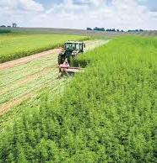
It is now legal to buy and sell hemp and hemp products in interstate commerce
The 2018 Farm Bill was designed to make the cultivation and processing of hemp legal just like any other farming operation

Slide 24
Regulatory Guidance
There is currently very little regulatory guidance for hemp farmers as the USDA has been slow to promulgate rules. Federal regulations are anticipated to be published in August
The states are all waiting on the USDA to do their job before developing state plans
Consequently, the current hemp growers are operating under the old rules established by the 2014 Farm Bill under pilot programs

Slide 25
A Cash Cow: Hemp
Highly Lucrative: 160 acres of hemp = $10,000,000
Many Products Made from Hemp:
beer, milk, shoes, protein powder, tea, coffee, hamburgers, rope, clothes, yoga pants, sunglass frames, soap, concrete, automobiles and pens, just to name a few

Slide 26
Acceptance of Hemp Businesses
Banks: reluctant but changing regarding opening accounts and lending. The federal government is working to develop federally backed loans to hemp farmers
IRS: still uncertainty over whether they will treat hemp biz similarly to marijuana and only allow deductions for cost of goods sold (IRC Section 280 (e))
The 2018 Farm Bill allows for crop insurance but it will likely take years to develop because of uncertainty over yields and exceptions for destruction of crops at the direction of a regulatory body

Slide 27
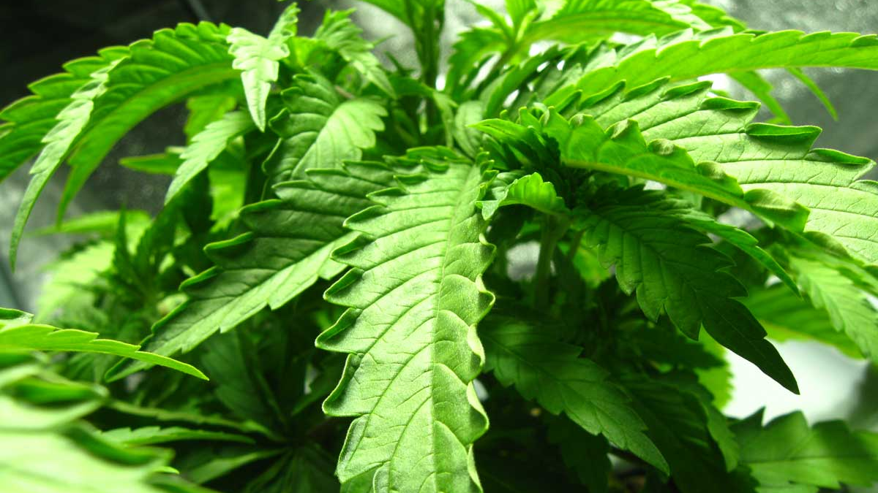
What is a Hot Plant?

Slide 28
Is Chapter 12 Relief Available for Hemp Farmers? Presumably so, but
Some of these businesses sell the THC which has been processed out of the biomass, which would be illegal under federal law
Then there is the problem of whether a Chapter 12 debtor does not properly dispose of the hemp if any of the plant or biomass is “hot” i.e. more then .3% THC? Does this expose the Trustee to liability?
Some states currently require a farmer, where there are a handful of hot plants, to cut down and dispose of the entire crop. What kind of impact would that have on a Chapter 12 plan?

Slide 29
The Receivership Option:
All states have some form of a statutory scheme for receiverships
But when it comes to receiverships for cannabis businesses its not always easy to have a receiver appointed
Colorado
Allows receivers to be appointed to take over an run a marijuana business but they have to licensed by the State’s regulatory body for overseeing marijuana. Yates v Hartman, 2018 COA 31, (Colo. App. 2018). They need an “Occupational Key” license for $250.

Slide 30
Colorado Licensing Requirements are difficult to navigate and expensive, for example…
A retail marijuana cultivation facility license may be issued only to a person who cultivates retail marijuana for sale and distribution to licensed retail marijuana stores, retail marijuana products manufacturing licensees, or other retail marijuana cultivation facilities. (Colorado Retail Marijuana Code 14-12-403).
The application fee alone is $5000 and there are local jurisdiction fees on top of this. (CRMC 14-12-501)

Slide 31
Receiverships for a Cannabis Business
Oregon
Has adopted regulations which allow for the receiver to be appointed as long as the receiver meets some very simple standards.
Proof that the person is the legal trustee, receiver for the business; and
A written request for authority to operate as a trustee or receiver, listing the address and telephone number of the trustee, receiver or personal representative.

Slide 32
Oklahoma SB 532
Andy Turner, a colleague of mine in Tulsa, drafted legislation for the appointment of a receiver for the purpose of making it simpler to have a receiver appointed for a medical marijuana business.
Codified as 12 O.S. Section 1560, the new law allows creditors of a medical marijuana business to have a receiver appointed to run the business during the pendency of the receivership, whether it is a dispensary, grow operation, or extraction company.

Slide 33
Disadvantages of a Receivership
*A receiver is often looking out for the best interest of the creditors that have selected him and not the debtor
*State receivership laws are not as well developed, creating uncertainty
*Many state court judges are unfamiliar with marijuana businesses
*And its expensive, anywhere from $10,000 a month to $40,000 a month for more complex cases

Slide 34
Questions? Comments?

