Slide 1
Hospital Restructurings
Cynthia Romano, CTP | FTI Consulting
Bill Kannel | Mintz
Felicia Gerber Perlman | McDermott Will & Emery

Slide 2
Healthcare Overview
Healthcare is made up of numerous subsectors that, each in their own right, is an industry. To talk about “healthcare” as a single industry doesn’t capture the complexity of the ecosystem, despite commonalities.

Slide 3
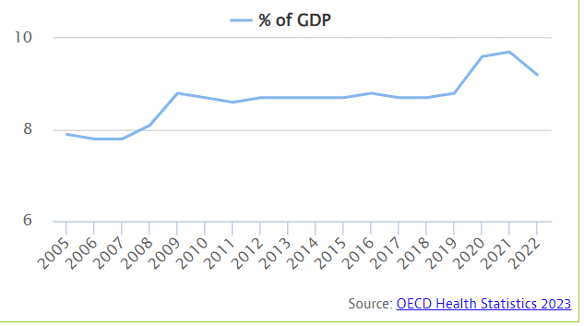
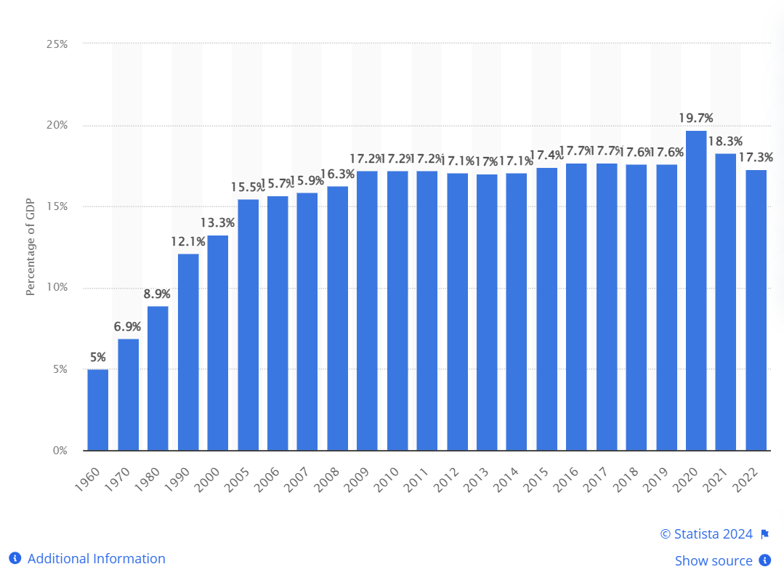
Healthcare in the U.S. is Broken
Expensive. We spend more on healthcare than any wealthy country
~5x higher than OECD countries
In relative dollars, we spend ~17.3% of GDP on healthcare
Ineffective. For all that money spent, we are not healthier or living longer.
Life expectancy of the average American is 78.8 years
We are only a fraction ahead of the Czech Republic, where out of pocket spend was $236 last year.
Providers Failing. While money is being spent, large quantities of it, providers are still not making it.
Health care bankruptcies in 2023 reached highest level in five years
2024 is expected to increase
Consumers Failing.
~20% of Americans report having medical debt
62% of consumer bankruptcies are related to medical debt

Slide 4
FTI Consulting’s Proprietary Distressed Healthcare Debt Model
As part of our ongoing industry practice, FTI Consulting monitors sector exposures. The following is non-investment grade/non-rated loans >$50 million
Overall Exposure by Subsector

Slide 5
Hospitals and Health Systems in Crisis: Drivers of Distress
Hospital distress puts lives at stake in acute care situations - actions that maximize liquidity are often at odds with patient needs and regulatory requirements. 2023 was troublesome. 2024 is expected to be worse.
DRIVERS
CMS/payor reimbursement
Revenue cycle/AR
Insurance/malpractice
Continued impact of No Surprises Act
PE – HC culture clash
Physician alignment/engagement
Loss leaders
High fixed assets
Ongoing labor pressures
Increased supply costs
High cost of capital
Total Healthcare Bankruptcies with >$25M in Liabilities^{[1]}
Quarterly Healthcare Bankruptcies with >$25M in Liabilities (1Q21-3Q23)

Slide 6
Hospitals and Health Systems in Crisis: Obstacles to Restructuring
The drivers causing distress create obstacles to restructuring easily or successfully while the outlook continues to get increasingly dark. 2024 is expected to be worse than 2023.
OBSTACLES
Demographics
Size impact
Provider agreements
Recoupment/setoff
Unions
Staffing agencies
Physicians opting out
MAAP payments
NFP and faith-based considerations
HIPAA and data protection
Licensing
Asset risk (drugs, equipment)
Anti-consolidation sentiment

Slide 7
Selected Features of Hospital Bankruptcies – Financing Issues
Political interference – particularly in sale context
Community impact
Unions – court visitors
Patient care ombudsman – HPITA
The “not for profit” mission – board duties
Financing issues

Slide 8
Selected Features of Hospital Bankruptcies – Financing Issues
Equipment, Inventory, Intellectual Property, Real Estate
Types of revenues
Healthcare insurance receivables - just another species of account
Self pay – will they be part of the lenders borrowing base?
Government payors - principally Medicare and Medicaid

Slide 9
Selected Features of Hospital Bankruptcies – Financing Issues
Government Payors – ≥ 50% of revenues
Recoupment / setoff – recoupment has won
Criminal and civil liability
Anti Kickback / Stark Law – strict liability
False Claims Acts / Fraud and Abuse – scienter
Police or regulatory power stay exception
11 USC §362(b)(28)
Transparent and proactive with CMS

Slide 10
Selected Features of Hospital Bankruptcies – Financing Issues
Anti-Assignment Provisions
Technically a set of statutes and regulations
Government has to pay the provider
Very clear you can borrow against them
Identifiable cash proceeds – "double" or "bifurcated“ lockbox with a daily sweep

Slide 11
Selected Features of Hospital Bankruptcies – Financing Issues
The Grab Bag
11 USC §552(a)
DIP
Cash collateral
Flop over / Replacement liens
Diminution
Are these accounts?
DSH payments - disproportionate share payments
Other government entitlements – state or federal
“Going concern” value
Charitable assets

Slide 12
Selected Features of Hospital Bankruptcies – Financing Issues
More Grab Bag
Bond financing
Health Care Districts – Chapter 9s

Slide 13
Fiduciary Duties
A director of a nonprofit corporation must discharge his or her duties as a director or a member of a committee.
When a nonprofit is insolvent the board of the nonprofit corporation, similar to the board of a for profit corporation, must consider the impact of their decisions on creditors.
The fiduciary duties of nonprofit boards are governed by state law, some states specifically require that the nonprofit board balance its decisions with the need to focus on the charitable purpose of the organization.

Slide 14
Board Liability
While some states have statutes limiting the liability of nonprofit board members others do not
While historically courts had found that there must be a finding of fraud, bad faith, self dealing or other similar actions for a nonprofit board member to have liability, courts have now found that nonprofit board members can have liability breaching their fiduciary duties through negligence
In In re Lemington Home for the Aged, the Third Circuit found the directors liable for failing to exercise reasonable prudence and care.
Therefore, while caselaw in the nonprofit board context is not as developed or clear as that for for-profit boards, best practices suggest that nonprofit boards follow the same guidelines as for-profit boards in exercising their fiduciary duties, particularly when there are solvency concerns

Slide 15
The Absolute Priority Rule
One of the requirements of the provisions governing plans of reorganization in Bankruptcy Code Section 1129(b) is that the plan must be “fair and equitable.”
Section 1129(b)(2)(B) also provides a statutorily defined requirement of the fair and equitable rule as it is applied to unsecured creditors, referred to as the “absolute priority rule,” which essentially requires senior classes (such as general unsecured debt) to be paid in full before the equity interest holders retain or receive any property under the plan if the senior classes do not approve the plan.
Though there are various ways to satisfy the absolute priority rule while allowing current equity interests holders to retain their interests, the absolute priority rule is intended to maximize the payment to creditors from the disposition of the debtor’s property.

Slide 16
The Absolute Priority Rule
In the case of a non-profit entity, however, there are no shareholders or equity interests. Therefore, courts often hold that the absolute priority rule is not applicable.
However, in some circumstances, where there are other forms of ownership interests, courts have found that the absolute priority rule does apply.
Courts often look to three factors:
Control
Profit sharing
Ownership of corporate assets

Slide 17
Determining Course of Action: Sale or Restructuring
Duty of Obedience
In a sale of a nonprofit health care business’s assets, the debtor must also consider whether the bids submitted further the institution’s stated mission.
Specifically, in addition to the duty of care and the duty of loyalty, directors of a nonprofit institution possess a “duty of obedience” to ensure compliance with the institution’s mission, the governing documents of the organization, laws applicable to the organization and the restrictions imposed by donors to the organization.
In the health care context, the consideration of public health, such as continuity of care for patients of a health care provider, might warrant approval of a sale even if there is a higher bidder or liquidation of the assets would provide more financial value to the estate.

Slide 18
Special Rules Involving Nonprofit Conversions
Internal Revenue Code Considerations
Many health care providers are nonprofit entities that qualify as tax-exempt organizations under § 501(c)(3) of the Internal Revenue Code (“IRC”). In order to qualify as a tax-exempt entity, the health care organization must satisfy the strict operational and organizational requirements set forth in § 501(c)(3) of the IRC.
One of the requirements is that the entity must be organized and operated exclusively for charitable purposes, and its net earnings must be used to accomplish these purposes without inuring, in whole or in part, to the benefit of a private person. The assets of the tax-exempt entity are considered dedicated to the furtherance of its exempt purposes, and upon dissolution are to be distributed in a manner to further this purpose.
A transfer of assets from a tax-exempt health care debtor to a taxable organization does not automatically result in the loss of tax-exempt status, but the Internal Revenue Service (IRS) will scrutinize the transaction to ensure that the debtor’s tax-exempt purpose has not been compromised.
If there is a material change in the character, purpose or method of the debtor’s operation as a result of the sale, or if the use of its assets will be inconsistent with its tax-exempt purpose, the health care entity may lose its tax-exempt status and the debtor may be liable for certain taxes associated with the transaction.
When conducting due diligence, the purchaser should consider whether its post-sale operations would fall within the debtor’s tax-exempt purpose. The purchaser should ensure that the purchase price is arrived at via an arm’s-length negotiation and that the purchaser will not engage in substantial lobbying or political campaigning, as is proscribed by § 501(c)(3) of the IRC.

Slide 19
Special Rules Involving Nonprofit Conversions
State Law Considerations
Laws governing the transfer of health care assets vary from state to state. Some states have “conversion” laws that govern the transfer of nonprofit assets to a for-profit entity. Other states permit the attorney general to provide oversight of the conversion of nonprofit assets.
It is also common for a state to require the attorney general to approve any transaction involving the sale of substantially all nonprofit health care assets. Guidelines differ, but in general, attorneys general will consider the following factors:
(1) whether the terms and conditions of the proposed transaction are fair and reasonable to the non-profit corporation;
(2) whether the proposed transaction will result in inurement to any private person or entity;
(3) whether the proposed transaction provides a fair-market value to the non-profit;
(4) whether the market value has been manipulated by the parties’ actions in a manner that causes the value to decrease;
(5) whether the proposed use of the assets from the proposed transaction is consistent with the “charitable trust” or mission of the non-profit entity;
(6) whether the proposed transaction constitutes a breach of trust;
(7) how the proposed transaction affects the public;
(8) whether the proposed transaction creates a significant effect on the availability or accessibility of health care services to the public; and
(9) whether the proposed transaction is in the public interest.

