Slide 1
Can Chapter 11 Still serve the middle market?
Moderator, Patrick J. Nash, Jr. – Kirkland & Ellis
Robert M. Fishman – Cozen O’Connor
Lindsey Henrikson – King & Spalding
Kenneth J. Malek – MalekRemian LLC
September 16, 2022
Chicago-Kent College of Law

Slide 2
PANELISTS
Patrick J. Nash, Jr.
Robert Fishman
Lindsey henrikson
Kenneth j. malek
Pat is a Partner in the Restructuring Group of Kirkland & Ellis LLP, representing a variety of clients in complex business reorganizations, troubled company M&A, debt restructurings, and financing matters.
Bob is a Member at Cozen O’Connor representing trustees, debtors, equity committees, secured and unsecured creditors, receivers and asset buyers and litigants in various insolvency proceedings, including informal out-of-court workouts.
Lindsey is a Senior Associate in the Corporate, Finance and Investments practice of King & Spalding, representing secured and unsecured creditors, debtors, and other parties in interest across a variety of industries.
Ken is the President of MalekRemian LLC and has over 30 years of experience assisting companies with de novo transactions, disputes and restructurings, including mergers and acquisitions, valuation, debt rationalization, turnaround and expert testimony.

Slide 3
BANKRUPTCY cases filed
Most filings in the last 10 years have been Chapter 7 or Chapter 13
Chapter 11 filings average ~7000 per year
Since February 2020, approx. 3000 Subchapter V filings
Chapter 11 only
0.8 - 1.7% of bankruptcy
filings

Slide 4
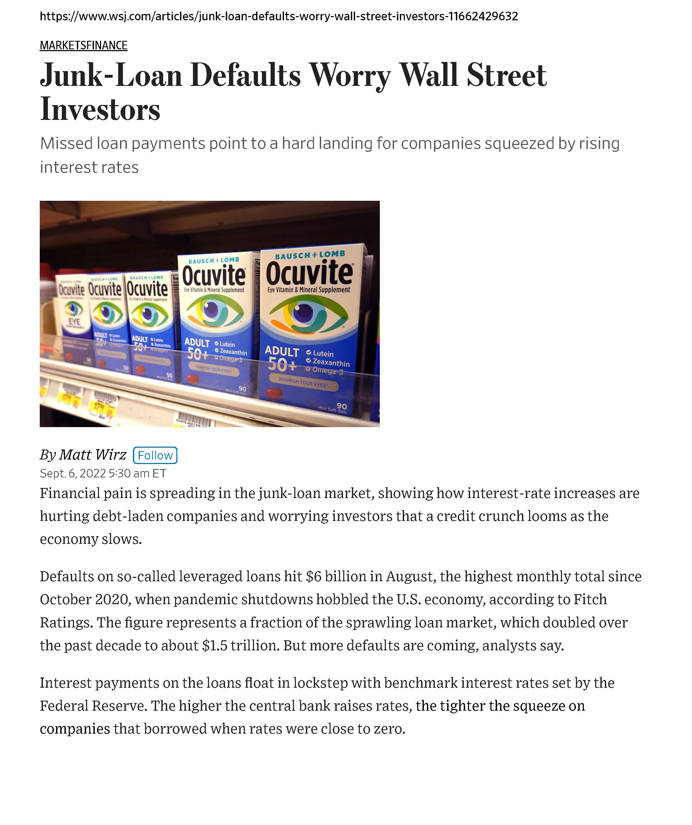
HOPE ABOUNDS FOR PROFESSIONALS WHO THRIVE ON ECONOMIC PAIN
“Defaults on so-called leveraged loans hit $6 billion in August [2022], the highest monthly total since October 2020, when pandemic shutdowns hobbled the U.S. Economy.”

Slide 5
Issues with MIDDLE MARKET chapter 11
Higher costs of middle market Chapter 11 relative to business enterprise value
1-2% of value of debtor’s assets in larger cases
4-5% of value of debtor’s assets in smaller cases
Duration of bankruptcy proceedings from filing to plan confirmation
Average is 232 days (in M.D. Fla) to 598 (in E.D.N.Y)
Increase in § 363 sales = decrease in reorganizations
What Does Chapter 11 Really Cost?
by Kenneth A. Rosen

Slide 6
Little space left for chapter 11 – large or Middle-Market
“Giant corporations make headlines when they file for Chapter 11, but they are no longer using it to rescue a firm from imminent failure. Many use Chapter 11 merely to sell their assets and divide up the proceeds.”
Central idea of corporate reorganization is for firm to continue as a “going-concern, to preserve the value of the firm above and beyond the liquidation of its assets
If assets can be more profitably employed elsewhere, sometimes standalone restructuring is not value maximizing, especially when considering business plan execution risk
Firm in financial distress now turn to Chapter 11 not to rehabilitate and reorganize, but to dispose of it
Only space left for Chapter 11 is in firms where specialized assets exist, assets must remain within a particular firm, control rights are badly allocated and/or going-concern sales not possible
The End of Bankruptcy
by Douglas G. Baird and Robert K. Rasmussen

Slide 7
RESTRUCTURING ALTERNATIVES
Traditional Chapter 11
Reorgs.
Higher fees in Middle-Market Cases - Little left for Unsecured Trade Creditors
Restructuring
Alternatives
363 Sales
Fulcrum Security Holder Cleanses
Debt Structure
UCC Foreclosures and Assignments for Benefit of Creditors
Secured Lender takes a Loss and
Re-lends Money Recovered

Slide 8
THE PARADIGM OF THE MELTING ICE CUBES – Non-monied creditors squeezed out
With the high costs of Chapter 11 relative to middle-market enterprise value, this generally results in one of two outcomes:
Many businesses are sold or liquidated with junior stakeholders and trade creditors deprived of material recovery value; or
Process drives the fulcrum security up the priority ladder, depriving lower-tier stakeholder of shares in the recovery
Sub-debt and second lien leverage model means all potential
sources of liquidity on the balance sheet are fully encumbered
Bank debt is typically first out, so the decades-old strategy of not
paying the junior principal and the junior interest does not generate
enough liquidity to fund the reorganization
So, if there is going to be a reorganization that fixes a broken business, some
stakeholder typically has to inject new funds. This is often through a 363 process, which deprives the junior stakeholders of recovery from the value of the business being fixed.
Sometimes this “fix” is as simple as a rebound in a commodity price, which was
temporarily distressed.

Slide 9
THE PARADIGM OF THE MELTING ICE CUBES – NON-MONIED CREDITORS SQUEEZED OUT
Takeaway and Questions:
Disconnect between total enterprise value and debt capacity
Middle-market businesses are valued by plan proponents in Chapter 11 on a distressed liquidating basis (including a going-concern liquidation), not on a reorganized basis, sometimes creating windfalls and depressing recovery values (liquidity problem vs. solvency problem)
Do opportunistic stakeholders use this dynamic/opportunity to game the system?
- OR -
Is the owner/buyer of the fulcrum security merely being compensated at the market rate for the risk of investment?

Slide 10
Courts generally clear the way to allow cleansing of the capital structure (without recoveries to lower-tier stakeholders) when there are appropriate circumstances
Cramdown allowed if “plan does not discriminate unfairly, and is fair and equitable,…to each class of claims or interests that is impaired under, and has not accepted, the plan” Sec. 1129(b)(2)(A)
In re River East Plaza, LLC, 669 F.3d 826 (7th Cir. 2012) – Secured lender – and not the debtor – allowed the economic benefit of anticipated recovery in collateral value: debtor’s alternative collateral package not the “indubitable equivalent”
RadLAX Gateway Hotel v. Amalgamated Bank, 132 S. Ct. 2065 (2012) – if asset to be sold free and clear, creditor must be allowed to credit-bid
Czyzewski v. Jevic Holding Corp., 137 S. Ct. 973 (2017) – bankruptcy court does not have power to priority-skip distribution schemes in Chapter 11 dismissals; not even in “rare cases”

Slide 11
How did we get here?
In re Braniff Airways (1982) – a case largely relegated to the dust bin: no sub rosa plans; proposed sale agreement tried to fix the terms of the reorganization
In re Lionel Corp. (1982) – must be “good business reason” for sale of assets outside of ordinary course; court does not have carte blanche to approve: must evaluate whether there is a melting ice cube and impact of the sale on ability to confirm a plan
In re Indus. Valley Refrigeration & Air Conditioning Supplies (1987) – preconfirmation sale of substantially all assets only allowed when good business reason is established, and burden of proving is heightened
In re George Walsh Chevrolet (1990) – sale of assets w/o Ch. 11 Disclosure Statement and Plan of Reorganization must be “closely scrutinized”
Clear Channel v. Knupfer (2006) – junior lienholder allowed to block 363 sale, but see In re Jolan (Bankr. W.D. Wash. 2008)
In re Whitehall Jewelers (2008) – especially when 363 sale proposed early in the case, the sale of substantially the debtor’s assets should be “closely scrutinized” and proponent of plan has heightened burden for proving elements necessary for approval

Slide 12
How did we get here?
In re General Motors Corp. (2009) – good business reason existed because GM had no liquidity of its own, need to quickly address consumer & fleet doubt, and U.S. Government funding contingent on 363 approval within days
In re Chrysler LLC (2009) – sale of substantially all the assets approved because it was the only way to preserve going concern value and thereby maximize creditor recovery
In re Philadelphia Newspapers and In re Pacific Lumber Co. (2009) – if claimant provided with “indubitable equivalent” of claim, collateral can be sold free and clear even if claimant not allowed to credit-bid
In re Saint Michael’s Medical Center, Inc. (2015) – debtors filed a sale motion on the first day of their chapter 11 cases to consummate a pre-negotiated sale pursuant to their stalking horse agreement. Liquidation plan confirmed approximately 6 months after sale.
In re Ample Hills, Inc. (2020) – debtors filed to consummate pre-negotiated sale at a depressed price during the peak of the COVID-19 pandemic in the second month of the cases. Sale consummated 4 months later and cases dismissed 6 months later.
In re Strike LLC (2022) – In the month after filing, the court approved a global settlement among the debtor, unsecured creditors, and its prepetition secured creditor / DIP lender as well as a 363 sale of substantially all assets to the DIP lender. Liquidating Plan confirmed 5 months later.

Slide 13
CASE STUDIES: Recent Examples Not Involving 363 Sales

Slide 14
RUBY TUESDAY
Ruby Tuesday confirmed a plan including a global settlement providing approximately a 3% recovery to unsecured creditors. Prepetition lenders were afforded a modest 40% recovery

Slide 15
Ruby Tuesday
Capital Structure | Reorganization Value | Recoveries to Funded debt | Recoveries to Equity | Recoveries to Unsecured Creditors | Resolution | Fees
Secured debt - $42.7M Unsecured debt - $28.8M | $17.5M | Prepetition term loan claims - $17.5M by electing either (i) cash or (ii) through (a) the reinstatement of claims, or (b) the return of collateral (with option to reduce to provide additional recovery to GUCs)(39% recovery) | No recovery | General unsecured creditors received approximately a 3% recovery in cash pursuant to settlement agreement | Cramdown on all general unsecured creditors, though a Rule 9019 settlement was reached to provide recovery to that class | $10,717,135 61% of reorganization value

Slide 16
EMERGE ENERGY SERVICES
Energy Services confirmed a plan after a four‑day contested hearing, with objections honing in on contemplated third‑party release provisions. The junior secured lenders received a modest recovery and did not receive the distribution in cash.

Slide 17
EMERGE ENERGY SERVICES
Capital Structure | Reorganization Value | Recoveries to Funded debt | Recoveries to Equity | Recoveries to Unsecured Creditors | Resolution | Fees
Secured debt - $225M No unsecured debt other than trade creditors | $315.6M – 210.9M | Prepetition secured credit agreement - $27.2M in cash (full recovery) Prepetition secured note claims – issuance of new notes & equity in reorganized company (38-55% recovery) | No recovery | No recovery | Cramdown on all general unsecured creditors | $15,667,964 4.96 – 7.4% of reorganization value

Slide 18
IN-SHAPE HOLDINGS
In‑Shape Holdings conducted a two‑step dismissal after selling substantially all assets to the stalking horse bidder whereby the GUCs were wiped out. The sale was objected to by various third parties, including, among others, various contractual counterparties of the Debtors

Slide 19
IN-SHAPE HOLDINGS
Capital Structure | Reorganization Value | Recoveries to Funded debt | Recoveries to Equity | Recoveries to Unsecured Creditors | Resolution | Fees
Secured debt - $63.4M Unsecured debt - ~$25M | $12.7M | Sale proceeds issued to non-purchasing secured debtholders in cash, but insufficient to provide full recovery (~20% recovery) | No recovery | No recovery | Sale to DIP lender and prepetition lender ($45.3M credit bid) | $3,561,188 28.0% of reorganization value

Slide 20
AMSTERDAM HOUSE CONTINUING CARE RETIREMENT COMMUNITY
Amsterdam House confirmed a first amended plan on an uncontested basis. Prepetition secured lenders propped up the company with additional bond investments and received a modest haircut on prepetition loan principal amounts.

Slide 21
Amsterdam HOUSE
Capital Structure | Reorganization Value | Recoveries to Funded debt | Recoveries to Equity | Recoveries to Unsecured Creditors | Resolution | Fees
Secured debt - $168M Unsecured debt - $3M | $153.4M | Certain existing bondholders provided exit financing/new debt of $40.7M Pre-existing debt was effectively reinstated at 91% of the prepetition amount | Upon $18m cash infusion separate from the new money infusion from bond holders; interests reinstated | All general unsecured creditors received a 15% pro rata distribution in cash | Cramdown on general unsecured creditors | $3,067,505 2.0% of reorganization value

Slide 22
LORD & TAYLOR
Lord & Taylor sought a cramdown of Class 4 of the GUCs due to the plan providing for a going-out-of-business sale, which limited distribution to certain classes, including Class 4.

Slide 23
LORD & TAYLOR
Capital Structure | Reorganization Value | Recoveries to Funded debt | Recoveries to Equity | Recoveries to Unsecured Creditors | Resolution | Fees
Secured debt - $137.9M No unsecured debt other than trade creditors | $44.1M | $35M in cash plus accrued and unpaid interest (~32% recovery) | No recovery | All general unsecured creditors received approximately an 8% recovery in cash | Cramdown on all unsecured creditors | $19,104,232 43% of reorganization value

Slide 24
BIBLIOGRAPHY
Clear Channel v. Knupfer, 391 B.R. 25 (B. A. P. 9th Cir. 2008)
Czyzewski v. Jevic Holding Corp., 137 S. Ct. 973 (2017)
In re Ample Hills, Inc., USBC Case No. 20-41559 (E.D.N.Y.)
In re Braniff Airways, Inc., 700 F.2d 935 (5th Cir. 1983)
In re Chrysler LLC, 576 F.3d 108 (2009)
In re Gen. Motors Corp., 407 B.R. 463 (Bankr. S.D.N.Y. 2009)
In re George Walsh Chevrolet, Inc., 118 B.R. 99 (Bankr. E.D. Mo. 1990)
In re Indus. Valley Refrigeration & Air Conditioning Supplies, Inc., 77 B.R. 15 (Bankr. E.D. Pa. 1987)
In re Lionel Corp., 722 F.2d 1063 (2d Cir. 1983)
In re Pacific Lumber Co., 584 F.3d 229 (5th Cir. 2009)
In re Philadelphia Newspapers, LLC, 599 F.3d 298 (3d Cir. 2010)
In re River East Plaza, LLC, 669 F.3d 826 (7th Cir. 2012)
In re Saint Michael’s Medical Center, Inc., USBC Case No. 15-24999 (N.J.)
In re Strike, LLC, USBC Case No. 21-90054 (S.D. Tex.)
In re Whitehall Jewelers Holdings, Inc., No. 08-11261 (Bankr. D. Del. July 28, 2008)
RadLAX Gateway Hotel v. Amalgamated Bank, 132 S. Ct. 2065 (2012)
Baird, Douglas G. & Robert K. Rasmussen, The End of Bankruptcy, 55 Stanford Law Review 751 (2002)
Rosen, Kenneth A., What Does Chapter 11 Really Cost?, The Bureau of National Affairs (Apr. 20, 2016)
Wolf, Amy R., Scott K. Charles & Alexander B. Lees, Recent Developments in Bankruptcy Code Section 363
Sales, The Review of Banking & Financial Services, Vol. 26, 2010.

Slide 25
Thank you!
And thank you to our hosts!

